Slide 1
Study Protocol
iPROVE Network Research Group
www.iprove.incliva.es
iPROVE-EAL Trial

Slide 2
iPROVE-EAL
CONSORT Flowchart
Patients undergoing emergency laparotomy
Informed consent before surgery
Intraoperative air-test
Positive
Negative
X patients not included
Randomized 732 patients
366 assigned to iOLA-iHFNC
(intraoperatively + 6 hours postoperatively)
366 assigned to STD-O₂
(intraoperatively + 6 hours postoperatively)
X Excluded
X Excluded
X included in the final analysis
X included in the final analysis

Slide 3
iPROVE-EAL
General Ventilatory Management
PRE-OXYGENATION: 5 minutes with 1.0 FIO₂
VENTILATORY SETTING: VT 8 ml/Kg ideal body weight
PEEP: 5 cmH₂O
RR to etCO₂ 35-45 mmHg
Plateau pause: 10% I:E= 1:2
Air-test
FIO₂ = 0.21 during the first 15 minutes or up to SpO₂ < 97%
Thereafter, the FIO₂ of 0.4 will be adjusted
Inclusion criteria
Positive air test = SpO₂ < 97% → RANDOMIZATION
Negative air-test = SpO₂ >=97% → NOT INCLUDED (Data will be reported)

Slide 4
INTRAOPERATIVE ventilatory management
STD-02 GROUP
General Ventilatory Management
VENTILATORY SETTING: VT = 8 ml/Kg ideal body weight *
FIO₂ = 0.4
PEEP: 5 cmH₂O
RR to etCO₂ 35-45 mmHg
Plateau pause: 10% I:E= 1:2
* If DP > 12 cmH₂O = decrease VT in 1 ml/kg steps until DP ≤ 12 cmH₂O
Monitoring of lung condition every 60 minutes
FIO₂ = 0.21 (air-test) for 5 minutes or up to SpO₂ < 97%
Rescue maneuver if SpO₂ <92%.
Rescue Maneuvers *
1. Increase FIO₂ in 0.1 steps
2. Increase PEEP in 2 steps until 10 cmH₂O
* The change from one level to another is made if the SpO₂ persists < 92%
Extubation maintaning the level of PEEP/CPAP

Slide 5
POSTOPERATIVE ventilatory management STD-02 GROUP
General management
All the patients will stay at PACU or ICU at least 6 hours
From extubation and during the first 15-30´ all the patients will be oxygenated with 0.4-0.6 FiO₂
15-30 min after PACU/ICU admission an Air-Test (breathing room-air for 5 minutes) will be performed
Ventury mask with 0.4 FIO₂ during 6 hours.
If SpO₂ <92% postoperative rescue maneuvers will be initiated (See protocolo)

Slide 6
INTRAOPERATIVE ventilatory management
iOLA-iHFNT GROUP
General Ventilatory Management
VENTILATORY SETTING: VT = 8 ml/Kg ideal body weight *
FIO₂ = 0.4
RECRUITMENT MANEUVER A + PEEP SETTING A (see template)
RR to etCO₂ 35-45 mmHg
Plateau pause: 10% I:E= 1:2
* If DP > 12 cmH₂O = decrease VT in 1 ml/kg steps until DP ≤ 12 cmH₂O
Monitoring of lung condition every 60 minutes
FIO₂ = 0.21 (air-test) for 5 minutes or up to SpO₂ < 97%
Positive air-test (SpO₂ <97 while breathing 0.21 FIO₂₎
RECRUITMENT MANEUVER A + PEEP SETTING A (see template)
Rescue maneuver if SpO₂ <92%.
Rescue Maneuvers *
1. RECRUITMENT MANEUVER B + PEEP SETTING B (see template)
2. Increase FIO₂ in 0.1 steps
* The change from one level to another is made if the SpO₂ persists < 92%
Extubation maintaning the level of PEEP/CPAP

Slide 7
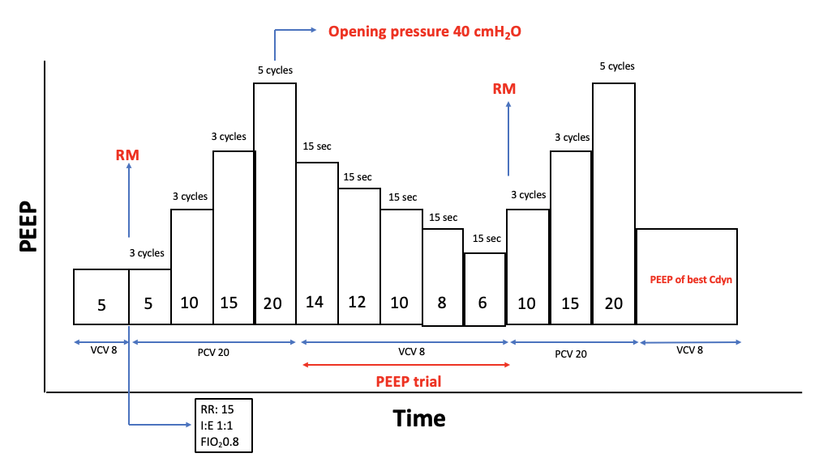
RECRUITMENT MANEUVER A + PEEP SETTING A
Clinical conditions for the RM
MAP >70 mmHg and or CI >2,5 ml/min/m²,
Adequate neuromuscular block with 0 of 4 (TOF).
If CI or MAP >50% during the RM:
Stop the RM and administer 5-15 mg de Ephedrine or 0,05-0,15 mg of phenilephrine.
Thereafter re-start de RM.
IF highest Cdyn appear with different PEEP values, select PEEP of lowest driving pressure (Pplat –PEEP)
IF Airway despresurization:
New RM and same PEEP level.

Slide 8
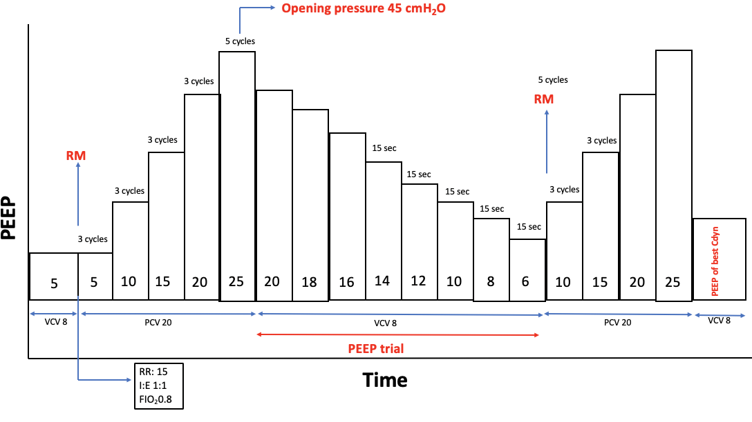
RECRUITMENT MANEUVER B + PEEP SETTING B
Clinical conditions for the RM
MAP >70 mmHg and or CI >2,5 ml/min/m²,
Adequate neuromuscular block with 0 of 4 (TOF).
If CI or MAP >50% during the RM:
Stop the RM and administer 5-15 mg de Ephedrine or 0,05-0,15 mg of phenilephrine.
Thereafter re-start de RM.
IF highest Cdyn appear with different PEEP values, select PEEP of lowest driving pressure (Pplat –PEEP)
IF Airway despresurization:
New RM and same PEEP level.

Slide 9
POSTOPERATIVE ventilatory management
iOLA-iHFNT GROUP
General management
All the patients will stay at PACU or ICU at least 6 hours
From extubation and during the first 15-30´ all the patients will be oxygenated with 0.4-0.6 FiO₂
15-30 min after PACU/ICU admission an Air-Test (breathing room-air for 5 minutes) will be performed *
Positive Air-test = High-flow nasal cannula with a flow rate of ≥ 50 lpm FIO₂ with 0.4 FIO₂ during 6 hours.
Negative Air-test = Ventury mask with 0.4 FIO₂ during 6 hours.
* To perform the Air-Test, the patient must meet a series of requirements:
1. Collaborative capacity with CGS> 13.
2. Richmond test score between -1 and +1.
3. VAS <4.
If SpO₂ <92% postoperative rescue maneuvers will be initiated (See protocolo)

